Slide 1




Working in Teams During a Crisis: What it Takes to Win?
Dr. Chrysostomi Maria Kyrillou
The Collective Intelligence Maturity Assessment Model

Slide 2
CRISIS Project
The Project proposes a holistic approach for the professional development of Smart City Resilience Officers.
It aims to develop a new job profile for Smart City Resilient Officers (SCROs) and to design, develop and deliver a pilot training program to certify the first cohort of SCROs.

Slide 3
CRISIS Project – Main Objectives
Provide in a structured and systematic way a framework for educating smart cities staff on resilience.
Develop an innovative curriculum for SCROs (currently there is none available).
Provide innovative learning tools.
Close the competence and skills gap for municipalities officials.
Promote the European Collaboration on smart cities’ education.
Increase the awareness of the Member States, Local Authorities, Municipalities and of various stakeholders that resilience of smart cities is a complex issue and that it is difficult to acquire competences.
Build upon important work delivered by previous ERASMUS+ projects undertaken by the partners, such as the SmartDevOps Project.

Slide 4
Problem Statement & Research Gap

Slide 5
Low Probability High Impact Events – LoPHIEs
(Problem Statement 1/3)
The management process
Conceptual definition of LoPHIEs
Threat (Engelbach et al., 2015; Hergert, 2004; Klein, 2007)
Decision Time (Mendoza, Poblete and Castillo, 2010)
Awareness – surprise effect (Marjanovic and Hallikainen, 2013; Turoff et al., 2004a, 2004b)
The event
Post-event
Pre-event
prevention and preparation
immediate response
recovery and review
(Bernstein, 2011; Coombs and Holladay, 2010; Coombs, 2007)

Slide 6
Decision Making
(Problem Statement 2/3)
High uncertainty reduces rationality (e.g., Dean and Sharfman, 1993; Fredrickson, 1985; Janis, 1983, 1989; Kahneman, Slovic and Tversky, 1982; Makridakis and Taleb, 2009; Pollack, 2003; Simon, 1987a, 1987b; Tversky and Kahneman, 1973).
Cognitive limitations in decision-making processes (e.g., Cosier and Schwenk, 1990; Eisenhardt and Zbaracki, 1992; Kersten, 2005; Papadakis, Lioukas, and Chamber, 1998; Pinfield, 1986; Pinker, 1997; Tetlock, 2017).
Existing approaches and methods used for the anticipation and management of LoPHIEs have fundamental limitations (Diakou and Kokkinaki, 2013).
Judgment or decision making biases = considerable impact on the quantification of probability, uncertainty and risk (e.g., Armstrong, 2006; Berg, Neumann, and Rietz, 2008; Fildes et al., 2009; Goodwin and Wright, 2010; Jakoubi, Tjoa, and Quirchmayr, 2007; Onkal and Gonul, 2005).

Slide 7
Problem Statement 3/3 and Research Gap
Low Probability Hight Impact Events (LoPHIEs)
Decision Making
Collective Intelligence (CI)

Slide 8
Collective Intelligence (CI)
CI through the outreach of many subjective views (which may carry biases individually), results into a diversity of assumptions, solutions, and beliefs, that collectively are found to mitigate human biases and lead to more objective decision outcomes (Bonabeau, 2009; Nickerson and Sakamoto, 2010; Prpić, Jackson and Nguyen, 2014; Prpić, Taeihagh and Melton, 2015).
Emerges from the collaboration of many individual entities and predicts how well a group will perform on a wide range of different tasks (Engel et al., 2015).
It can be defined as the general ability of a group to perform a wide variety of tasks (Woolley, Aggarwal and Malone, 2015).
Factors significantly correlated with CI:
Average social sensitivity of team members - RME level of the team (Baron-Cohen et al., 2001a; Elfenbein, 2006; Elfenbein, Polzer, and Ambady, 2007; Engel et al., 2014).
Proportion of the female participants in the team (Baron-Cohen, 1997; Engel et al., 2014).
Equal distribution of conversational turn-taking and participation in discussion - Team interaction level (Kim et al., 2015 and Pentland, 2010).

Slide 9

Aim
What are the significant factors that need to be included in a CI maturity assessment model examining the preparedness of organizations for managing LoPHIEs?
Design and develop a CI maturity model for the assessment of organizations’ preparedness and resilience towards LoPHIEs.
Main Research Question

Slide 10
Research Objectives |  |  | Research Strategies & Techniques
R.O. 1 | Identify indicators related to the management of LoPHIEs. |  | Secondary Data Collection / Literature Review
R.O. 2 | Explore indicators related to the management of LoPHIEs in the presence of CI-supported decision making. |  | Secondary Data Collection / Literature Review Multiple Experiments
R.O. 3 | Design and develop a CI maturity assessment model. |  | Secondary Data Collection / Literature Review Expert Opinion Multiple Experiments
R.O. 4 | Validate how the proposed CI maturity assessment model can be applied to assess teams’ maturity levels in dealing with LoPHIEs. |  | Multiple Experiments

Slide 11
Research Outline
Indicators and factors, which are of critical importance for the evolution and maturation of CI in teams and Collective Performance in relation to the management of LoPHIEs, have been investigated at a theoretical level.
The analysis of the primary data led to a new model for maturity assessment. This model has resulted following a design science research methodology, with two iterations of the development cycle.
During the first development cycle, an initial design of the CIMA Model has been proposed. In addition, an initial analysis of the primary data collected was performed and resulted into the identification of additional factors, which in turn advised the second iteration of the development cycle.
3.1
1
2
3
3.2
During the second development cycle an improved design of the CIMA Model has been proposed and a complete analysis of the primary data has been conducted. In the last phase of the second development cycle, the results of the data analysis were taken into consideration, and a final design of the CIMA Model has been proposed. The final design integrates in full the maturity of the phenomenon under study.
Three interconnected experiments were conducted, and primary data were collected. Indicators and factors important for the evolution and maturation of CI and Collective Performance in relation to the management of LoPHIEs, have been investigated at an empirical level.

Slide 12
Collective Intelligence Maturity Assessment (CIMA) Model – Development Process
Maturity Model Development Cycle
(adapted from Mettler, 2011)
define scope
design model
Identify need or new opportunity
reflect evolution
evaluate
design

Slide 13
The g Factor
Definition, Theoretical Origins & Implications
Predictive Validity of General Intelligence
The c Factor
Definition, Theoretical Background & Implications
Factors Significantly Correlated with CI
Predictive Validity of CI
Diversity & its Impact on CI
Collective Decision Making
Heuristics & Cognitive Biases
Theoretical Background
Two Cognitive Systems: The Dual Process Model
Heuristics & Cognitive Biases sees as Adaptive Responses to Situations
Most Prominent Heuristics & Cognitive Biases Affecting Judgement
Availability and Representativeness Heuristics
Cognitive Dissonance and Hindsight Bias
Collective Intelligence
Transactive Memory Systems (TMS)
Crowdsourcing
Evolution, Forms, Methods & Different Domain Applications
Crowdsourcing in the Field of Crisis and Disaster Management
Decision Making
Maturity Assessment Models
Treatment of Choice Under Uncertainty
Beliefs
Overconfidence
Expert Prediction Fails
Distinction between Risk and Uncertainty
Strategic Decision Making – Rationality vs. Bounded Rationality
Maturity Assessment Models
A Generic Model for Maturity Assess.: Origins, Nature & Use
Design & Development of Maturity Assess. Models
Criticism on the Concept of Maturity Assess.
Selected Maturity Assess. Models and their Relation to LoPHIEs
Risk Management Maturity Model
CMM
BPMM
P-CMM

Slide 14

Multiple Experiments Design – Materials & Methods
Protocol
Control group
Experimental group
Experiment 1 – Measured individual intelligence (included 3 psychometric tests which all participants were required to complete individually).
Experiment 2 – Measured Collective Intelligence (included 3 tasks that participants were required to complete either working individually - control mode or in teams - experimental mode).
Experiment 3 – Measured the Construct of Transactive Memory System TMS (included a TMS scale which participants of the experimental group were required to complete individually).
No Collective Intelligence
Collective Intelligence

Slide 15
Multiple Experiments Design – Materials & Methods
Participants:
154 participants, including professionals and students, were initially recruited to participate in the experiments.
57 participants were excluded due to failure to attend the whole experiment protocol.
3 more participants were recruited to achieve a sample of 100.
Total sample (N=100):
49 female / 51 male, Age: 20 – 57, 9 nationalities
65 – professionals, 35 – senior or postgraduate students
Professionals:
29 high risk manag. relevance
8 medium - high risk manag. relevance
11 medium risk manag. relevance
17 low - medium risk manag. relevance
Senior or postgraduate students:
35 low relevance to risk manag.

Slide 16
Exp. 1 Individual Intelligence
Reading the Mind in the Eyes Test
Folk Physics Test (Part I)
Big Five Personality Test

Slide 17
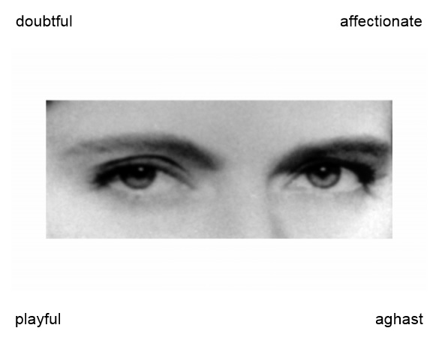
The ‘’Reading the Mind in the Eyes’’ test – An Example
Considered as an ‘advanced theory of mind test’. Theory of Mind is the component of EI with the greatest relevance to studies of CI due to the fact it encompasses the accurate representation and processing of information about the mental states of other people, also known as “mentalizing ability” (Baron-Cohen et al., 2001a), which contribute to successful interaction with others.
Has been shown to have satisfactory test-retest reliability (Hallerbäck et al., 2009).
Several studies suggest that it measures a fundamental property of individual brain function (e.g., Baron-Cohen et al., 2001b; Chapman et al., 2006; Domes et al., 2007).

Slide 18
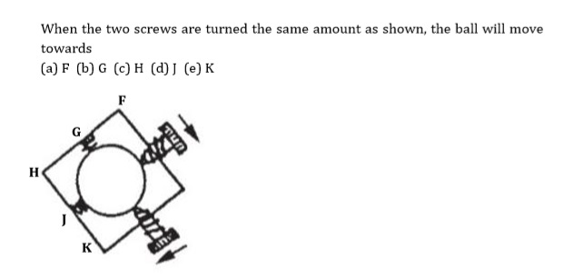
The “Folk Physics” test – An Example
Measures how physical-causality is perceived and understood as well as skills developed for understanding expectations concerning the motion and properties of physical objects (Leslie and Keeble, 1987), and concepts related to mechanics (Karmiloff-Smith, 1999).
Developed and validated by Baron-Cohen et al. (2001b).

Slide 19
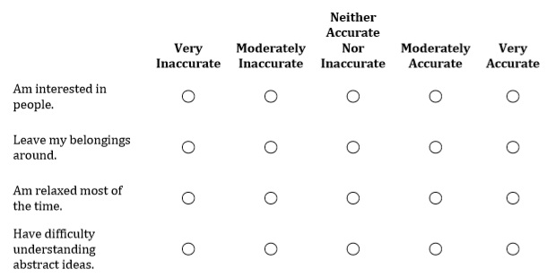
The “Big Five Personality” test – An Example
Measures the big five personality traits using the IPIP Big-Five Factor Markers from the International Personality Item Pool, developed by Goldberg (1992).
1. Extraversion, 2. Agreeableness, 3. Conscientiousness, 4. Emotional Stability, 5. Intellect or Imagination
Individual personality traits were measured in the experiment by the Big Five Personality Test in order to:
determine whether personality traits are positively correlated with human’s ability to make inferences about notions of the physical world as well as their capacity to explain and predict the mental state of other people.
explore the relationship between personality traits and CI in the context LoPHIEs.

Slide 20
Exp. 2 Collective Intelligence
Emergency Planning Activity – Case Study (Quadrant I)
Folk Physics Test Part II (Quadrant II)
Tsunami Disaster Scenario (Quadrants III & IV)

Slide 21
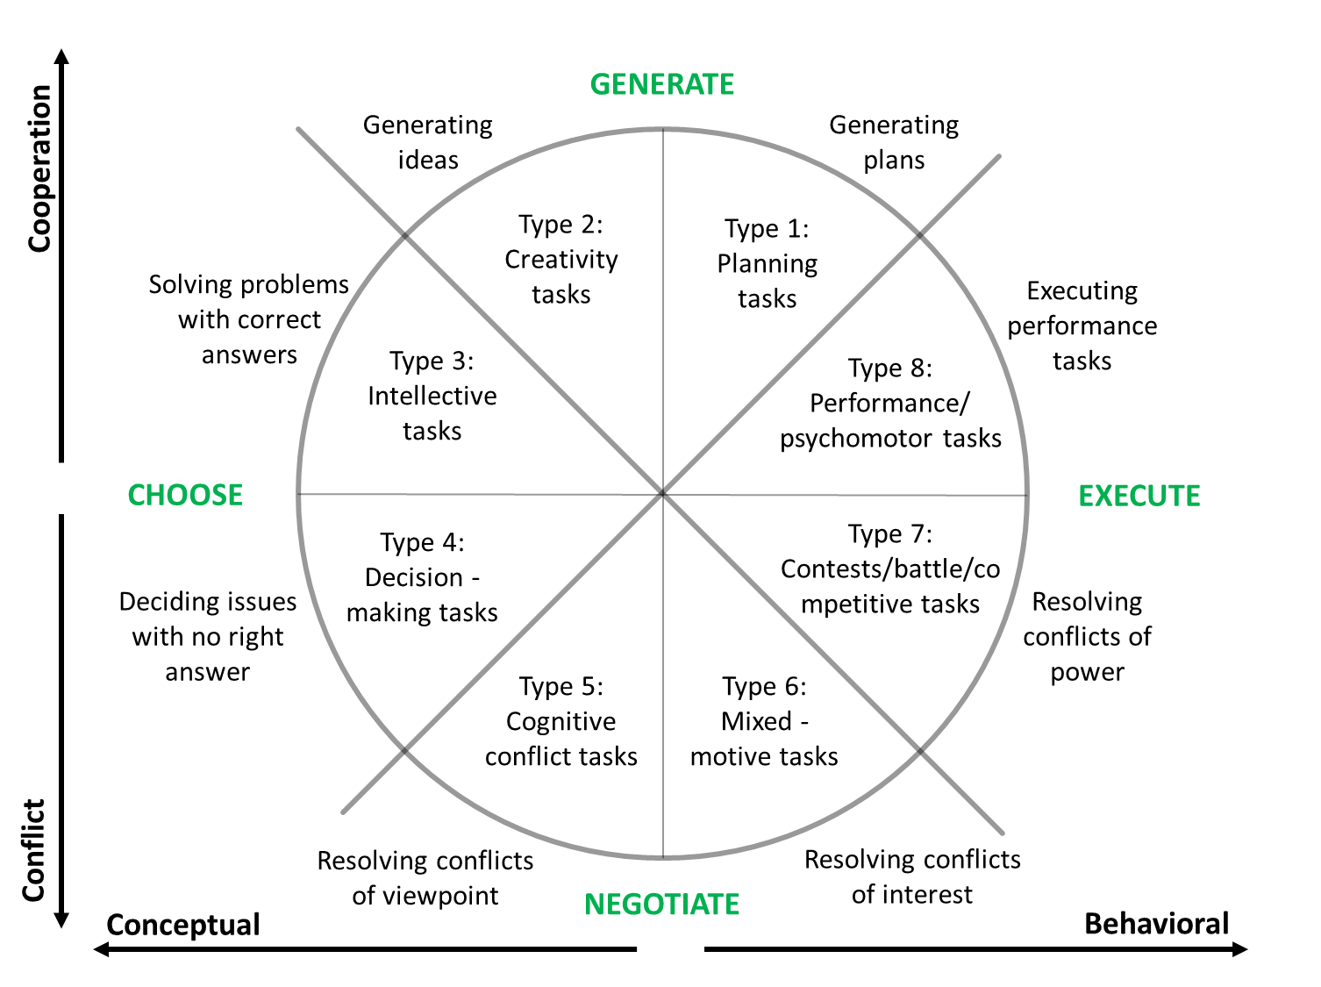
McGrath Task Circumplex
The set of the tasks used in the experiment was based on established taxonomies of team tasks (Larson, 2010; McGrath, 1984) and similar tasks used in prior studies in the field of collective intelligence (e.g. Engel et al., 2014; Engel et al., 2015; Woolley et al., 2010; Woolley et al., 2013).
McGrath Task Circumplex - established and validated taxonomy characterizing tasks according to the dominant coordination process required for its accomplishment by a team (McGrath, 1984)
McGrath Task Circumplex (adopted from McGrath, 1984)

Slide 22
Task 1 – Emergency Planning Activity – Case Study (Quadrant I)
Designed based on material obtained from a course offered by The Federal Emergency Management Agency’s (FEMA’s) Independent Study Program. The Federal Emergency Management Agency is a division of the United States Department of Homeland Security, committed in helping people before, during, and after disasters. The course has been developed for emergency management personnel involved in developing efficient emergency planning systems and offers training in the fundamentals of the emergency planning process.
The task:
Case study on Emergency Planning
2 open-ended questions
2 multiple-choice questions (with only one correct answer)
Duration – 20 mns
Supporting Material was provided to all participants, covering topics on:
emergency planning process
main steps of emergency planning
parties involved in the planning process

Slide 23
Tsunami Disaster Scenario (Quadrants III & IV)
(TASK 3)
Designed based on material adopted by Stop Disasters! a resource management and strategy game developed to educate about the warning signs of disasters and the methods of reducing casualties and impact as a result of natural catastrophes. The game has been launched by the United Nations International Strategy for Disaster Reduction and many organizations such as the International Federation of Red Cross and the Center for Research on the Epidemiology of Disasters as well as experts on education, emergency management scenario development and disaster risk reduction, have participated in the development of its contents and the making of the game.
To help solve the 3 activities involved in the tasks, Fast Facts about tsunamis were provided to all participants, covering:
What is a tsunami
Elements most at risk during a tsunami
How communities can be more protected against tsunamis
Participants were given 10 minutes to read the Fast Facts sheet and asked to remember as much information as possible, as they were not allowed to take notes of any kind on the information provided on tsunamis.

Slide 24
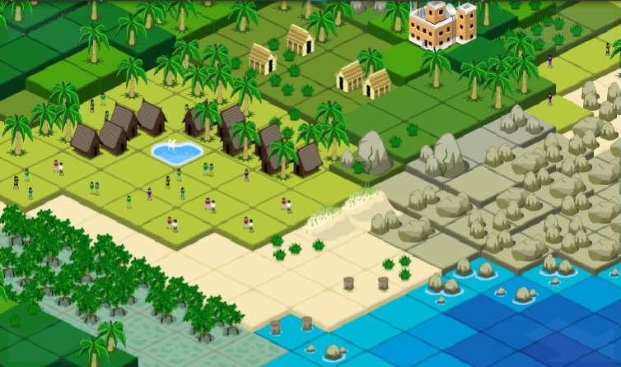
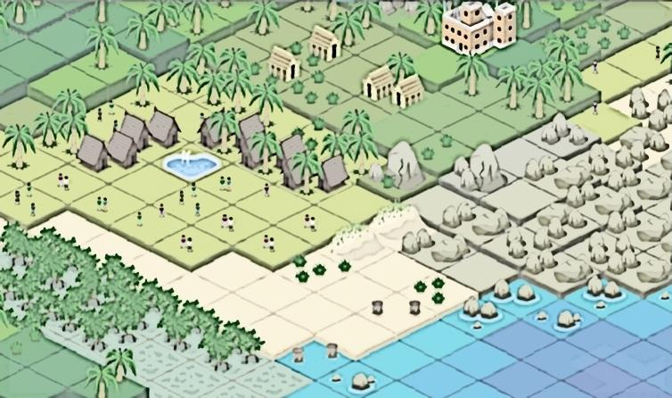
In relation to the below map (item 1), using the colouring pencils provided, indicate in the map below the level of risk, each tile is exposed to.
1 |  | 2 |  | 3 |  | 4 |  | 5
The map below, which is an overview of the current area you are requested to work on, encompasses 5 levels of risk.
Based on which factor/s is the map separated into different levels of risk?
The risk map has 5 levels of risk which range from green to pink:
Pink tiles are at most risk, green at the least risk (1 Green, 2 Yellow, 3 Orange, 4 Red, 5 Pink).

Slide 25
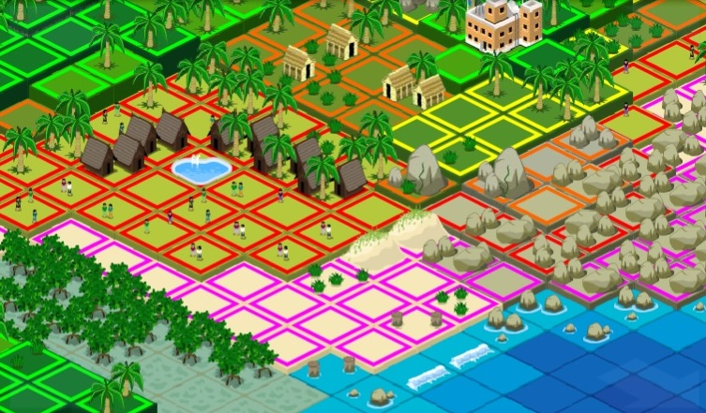

Slide 26
Indicate with ‘’ X ’’ the best location (tile) on the map, to build a hospital and explain why?

Slide 27
Exp. 3 Transactive Memory
TMS Measurement Model

Slide 28
The “TMS Measurement Model’’ – An Example
Developed by Lewis (2003)
Measures the three components of TMS developed within teams (Akgün et al., 2005; Kanawattanachai and Yoo, 2007; Lewis, 2004).
SPECIALIZATION
CREDIBILITY
COORDINATION

Slide 29
Collective Intelligence Maturity Assessment (CIMA) Model – Development Process
Second Development Cycle
Maturity Model Development Process
(adapted from Mettler, 2011)
Define scope
design model
Identify need or new opportunity
reflect evolution
evaluate
design

Slide 30
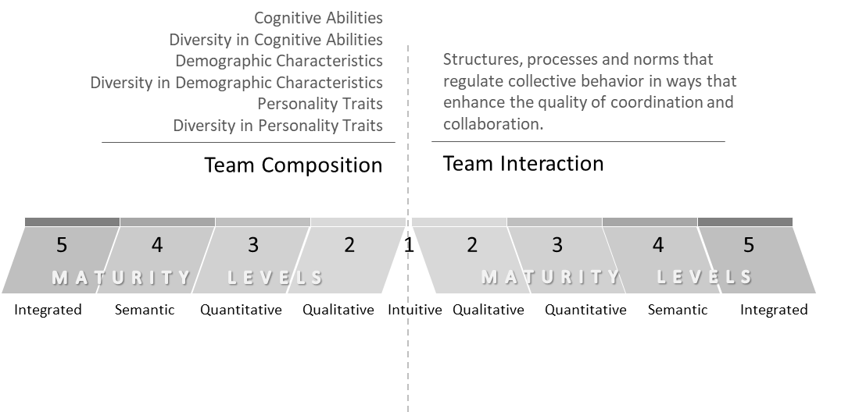
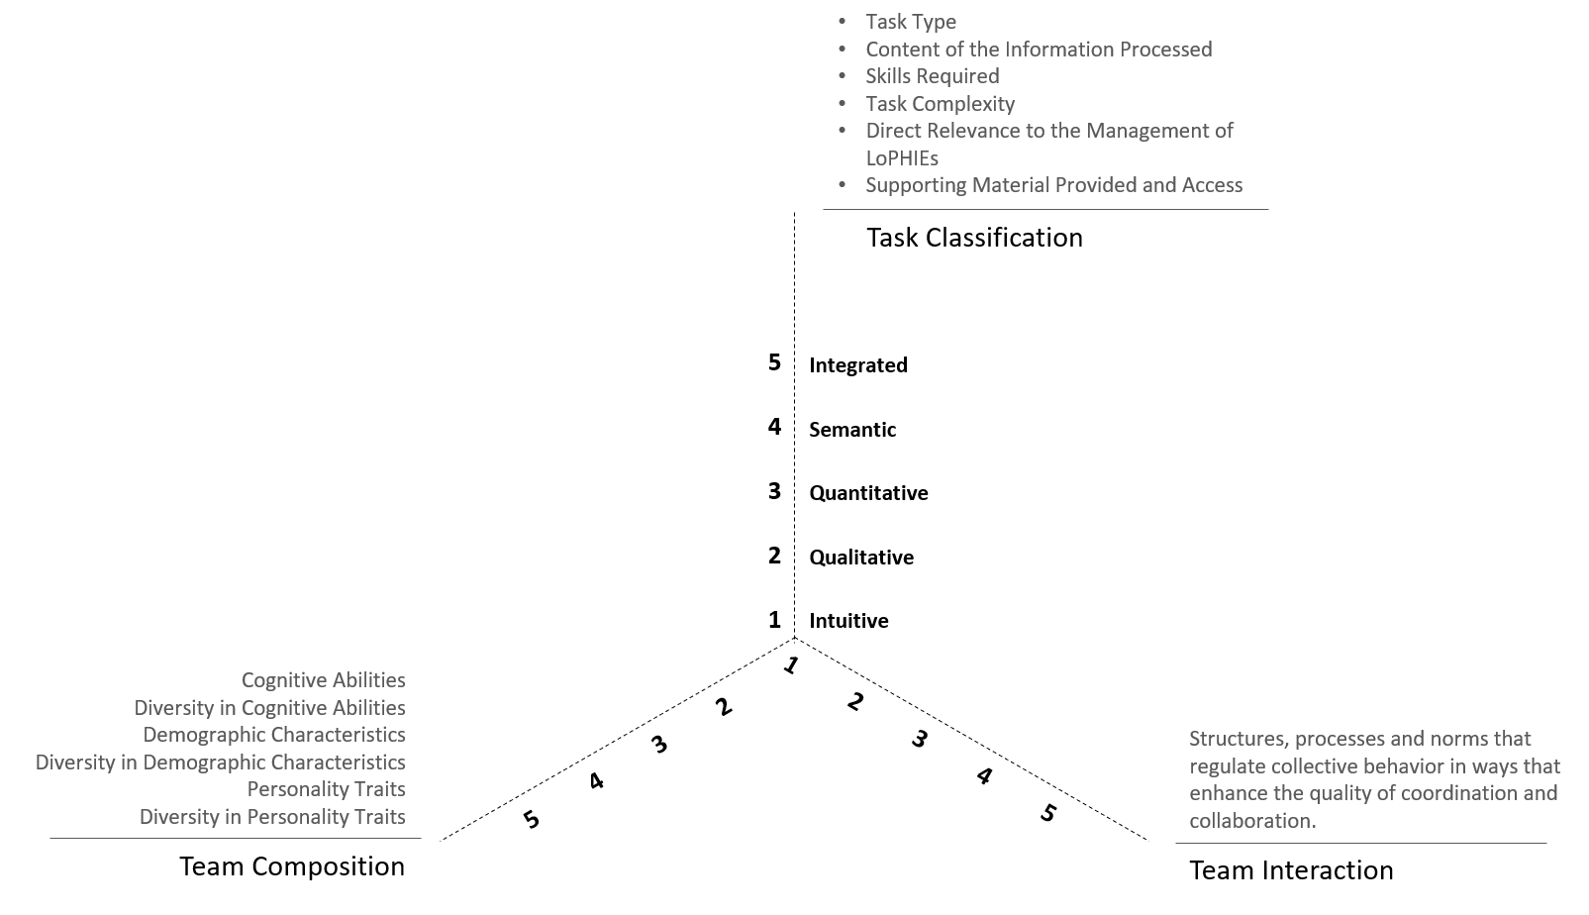
Evolution of the CIMA Model after the Completion of the First Development Cycle
CIMA Model – Improved Design
CIMA Model – Initial Design

Slide 31
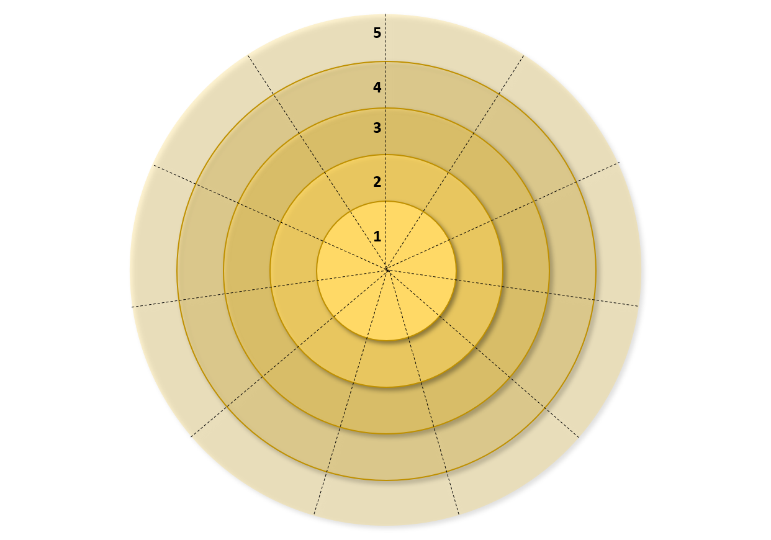
CIMA Model – Final Design
Task Type
Content of the Information Processed
Skills Required
Task Complexity
Direct Relevance to the Management of LoPHIEs
Supporting Material Provided and Access
Ability of understanding social causality (RME)
Ability of understanding physical causality (Folk Physics Test Part I)
Integrated
Task
Classification
Semantic
Risk Management Relevance RMR
Quantitative
Team Interaction
Structures, processes and norms that regulate collective behavior in ways that enhance the quality of coordination and collaboration.
Qualitative
Intuitive
Diversity
in age
Specialization
Agreeableness
Diversity in Extraversion
Extraversion
Diversity in Agreeableness

Slide 32
TEAM COMPOSITION Factors identified to positively influence the evolution and maturation of CI in teams and Collective Performance: 1. Ability of understanding social causality (as measured by the Reading the Mind in the Eyes RME test), 2. Ability of understanding physical causality – ability of spontaneously understanding the workings of the physical world (as measured by the Folk Physics test), 3. Risk Management Relevance RMR, 4. Diversity in age, 5. Agreeableness, 6. Extraversion, 7. Diversity in Agreeableness, 8. Diversity in Extraversion
Maturity Level 1: Intuitive | Maturity Level 2: Qualitative | Maturity Level 3: Quantitative | Maturity Level 4: Semantic | Maturity Level 5: Integrated
• Teams are formed with complete ignorance of how specific factors related to Team Composition, positively influence the evolution and maturation of CI in teams as well as Collective Performance. • There is a lack of formal tools to measure these factors in the teams. | • The specific factors related to Team Composition identified to positively influence the evolution and maturation of CI in teams as well as Collective Performance are intuitively assessed and analyzed. • There is still a lack of formal tools to measure these specific factors. | • There is a factual assessment and analysis of the specific factors identified to positively influence the evolution and maturation of CI in teams as well as Collective Performance, with some awareness of their positive effects. • Some tools to measure these specific factors are in place, offering some reporting and metrics. | • Intuitive team modification takes place based on specific factors related to Team Composition. • There is a good understanding of how these specific factors positively influence CI and Collective Performance. • Formal tools to measure these specific factors are in place, offering advanced reporting and metrics. | • There is informed team modification based on specific factors related to Team Composition. • There is a comprehensive understanding of how these specific factors positively influence CI and Collective Performance. • There is extensive use of supportive tools to measure the specific factors of Team Composition, offering measurable results.
TRANSACTIVE MEMORY SYSTEM (TMS) Factors identified to positively influence the evolution and maturation of CI in teams and Collective Performance: 1. Specialization
Maturity Level 1: Intuitive | Maturity Level 2: Qualitative | Maturity Level 3: Quantitative | Maturity Level 4: Semantic | Maturity Level 5: Integrated
• There is complete ignorance of how transactive memory, as a collective mechanism, forms the style in which teams encode, store and retrieve information. • Teams are formed with ignorance of how Specialization may positively influence the evolution and maturation of CI in teams as well as Collective Performance. • It is generally considered that the performance of each team member relies solely on their own knowledge. • There is a lack of formal tools to measure the transactive memory system developed in teams. | • The specific TMS component of Specialization is intuitively assessed and analyzed. • It is generally considered that the performance of each team member relies solely on their own knowledge. • There is still a lack of formal tools to measure the component of Specialization in the teams. | • There is a factual assessment and analysis of Specialization, with some awareness of how this specific TMS component, positively influences CI and Collective Performance. • The idea that the performance of each team member may not depend solely on their own knowledge, but also the knowledge of others in their team, is being considered. • Some tools to measure Specialization in the teams are in place, offering some reporting and metrics. | • Intuitive team modification takes place based on the specific TMS component of Specialization. • There is a good understanding of how this specific TMS component positively influences CI and Collective Performance. • There is a good understanding of the fact that the performance of each team member relies on the collective knowledge of the team. • Formal tools to measure Specialization in teams, are in place, offering advanced reporting and metrics. | • There is informed team modification based on the specific TMS component of Specialization. • There is a comprehensive understanding of how this specific TMS component positively influence CI and Collective Performance. • There is a comprehensive understanding of the fact that the performance of each team member relies on the collective knowledge of the team. • There is extensive use of supportive tools to measure Specialization in the teams, offering measurable results.
CIMA Model – Maturity Levels Definitions

Slide 33
TEAM INTERACTION Structures, processes, and norms that regulate collective behavior in ways that enhance the quality of coordination and collaboration
Maturity Level 1: Intuitive | Maturity Level 2: Qualitative | Maturity Level 3: Quantitative | Maturity Level 4: Semantic | Maturity Level 5: Integrated
• Team Interaction is at a low level, with no presence of knowledge sharing. • There is complete ignorance of how structures, processes, and norms regulate collective behavior in ways that enhance the quality of coordination and collaboration. • There is ignorance of the fact that Team Interaction is influenced by the characteristics of the situation at hand (Task Classification) and the way in which individual and collective task representations are developed in teams. • Formal tools to measure Team Interaction level are absent. | • Team Interaction is at a low-medium level, with limited knowledge sharing. • Structures, processes, and norms that regulate collective behavior are intuitively being considered. • The Team Interaction level is intuitively assessed and analyzed, but formal tools to perform a comprehensive assessment are absent. | • Team Interaction is at a medium level, with improved knowledge sharing and communication style. • Some supportive tools to measure Team Interaction levels are in place, offering some reporting and metrics. • There is a factual assessment and analysis of the structures, processes, and norms that regulate collective behavior, with some awareness of their effect on the quality of coordination and collaboration. | • Team Interaction is at a medium-high level, with extensive knowledge sharing. • There is an improved understanding of the structures, processes and norms that regulate collective behavior, and their positive effect on the quality of coordination and collaboration. • Formal tools to measure Team Interaction are in place, offering advanced reporting and metrics. | • Team Interaction is at a high level, with broad knowledge sharing. • There is a comprehensive understanding of how structures, processes, and norms regulate collective behavior in ways that enhance the quality of coordination and collaboration. • There is extensive use of tools to measure Team Interaction level, offering measurable results.
TASK CLASSIFICATION Factors identified to positively influence the evolution and maturation of CI in teams and Collective Performance: 1. Task Type (Closed, Open-ended, combination of both), 2. Content of the Information Processed (based on the social or analytic/non-social cognitive domain), 3. Skills Required for the completion of the task (accuracy, coordination, combination of both), 4. Task Complexity (low, medium, high), 5. Direct Relevance to the Management of LoPHIEs, 6. Supporting Material Provided and Access
Maturity Level 1: Intuitive | Maturity Level 2: Qualitative | Maturity Level 3: Quantitative | Maturity Level 4: Semantic | Maturity Level 5: Integrated
• There is complete ignorance of how specific characteristics of the situation at hand (Task Classification) and the way in which individual and collective task representations are developed in teams, influence the evolution and maturation of CI as well as Collective Performance. • There is a lack of formal tools to measure the characteristics of the situation at hand. | • The specific factors identified to positively influence the evolution and maturation of CI in teams as well as Collective Performance in relation to Task Classification are intuitively assessed and analyzed. • There is still a lack of formal tools to measure these specific factors. | • There is a factual assessment and analysis of the specific factors related to Task Classification, with some awareness of their positive effects on the evolution and maturation of CI in teams as well as Collective Performance. • Some tools to assess the characteristics of the situation at hand are in place, offering some reporting and metrics. | • There is a good understanding of how specific factors related to Task Classification, positively influence CI and Collective Performance. • Formal tools to measure the characteristics of the situation at hand, are in place, offering advanced reporting and metrics. | • There is a comprehensive understanding of how specific characteristics of the situation at hand (Task Classification) and the way in which individual and collective task representations are developed in teams, influence the evolution and maturation of CI as well as Collective Performance. • There is an extensive use of supportive tools to assess the characteristics of the situation at hand, offering measurable results.
CIMA Model – Maturity Levels Definitions

Slide 34
Main Findings

Slide 35
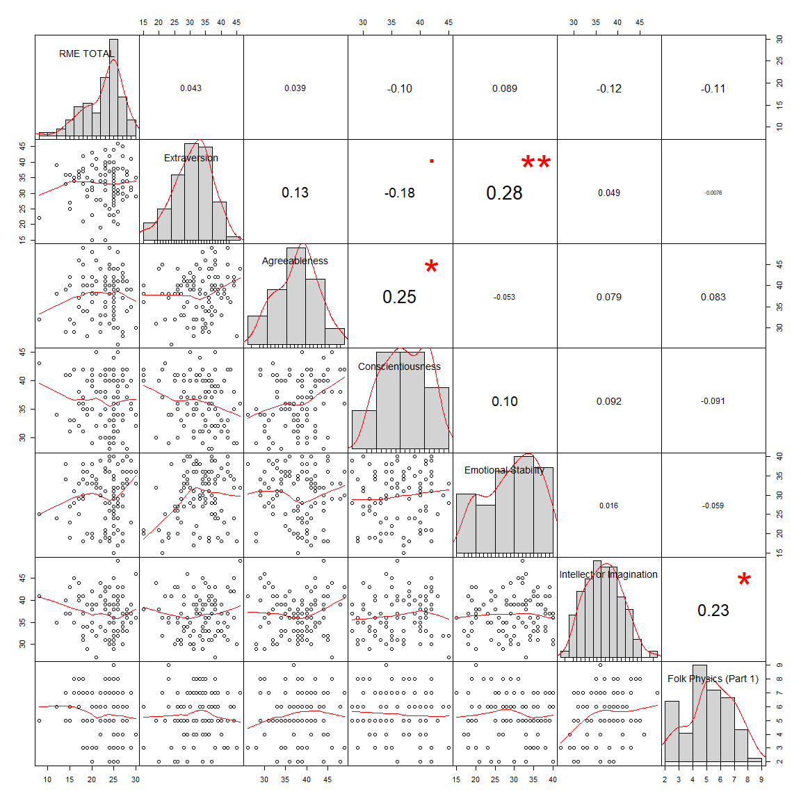
The ability of understanding social causality, as measured by the Reading the Mind in the Eyes Test RME has low to zero correlations (r<0.10) with the five primary dimensions of adult personality, as measured by the Big Five Personality Test (Extraversion: r=0.043, Agreeableness: r=0.039 Conscientiousness: r=-0.104, Emotional Stability: r=0.089, Intellect or Imagination: r=-0.118).
Matrix Scatterplot for the associations between Experiment 1 measurements

Slide 36
Belonging in a team is associated with higher Collective Performance (Total Task Score) as compared to working individually (b=0.34, p=0.066).
The findings support the findings of previous studies that provide evidence that collective problem-solving leads to enhanced performance and improved solutions that no individual can achieve alone (e.g., Gulley and Lakhani, 2010; Jeppesen and Lakhani, 2010).
A higher level of Collective Intelligence is associated with higher Collective Performance.
The finding supports the findings of previous studies that strongly suggest that CI predicts how well a team will perform on a wide range of different tasks (Engel et al., 2015; Woolley, Aggarwal and Malone, 2015 and Woolley et al., 2010).

Slide 37
Higher levels of EI in the team are associated with a higher level of performance. Specifically, the current research suggests that Theory of Mind ToM (as measured by the Reading the Mind in the Eyes RME test) and, consequently EI, have a predictive power of over the performance outcomes of teams.
The findings are in line with the findings of numerous previously conducted studies that investigate the relationship between ToM/EI and performance (e.g., Engel et al., 2014; Kidwell et al., 2011; O’Boyle et al., 2011; Joseph and Newman, 2010; Joseph et al., 2015; Lopes, 2016; Boyatzis, Good and Massa, 2012; Boyatzis et al., 2015; Boyatzis, Rochford and Cavanagh, 2017).
The results obtained in regards to team diversity, confirm the notion that teamwork output is the result of multiple mechanisms that may interact; and that diversity in skills, knowledge and demographic characteristics, including personality traits, as well as the characteristics of the task at hand, affect team performance through multiple channels.

Slide 38
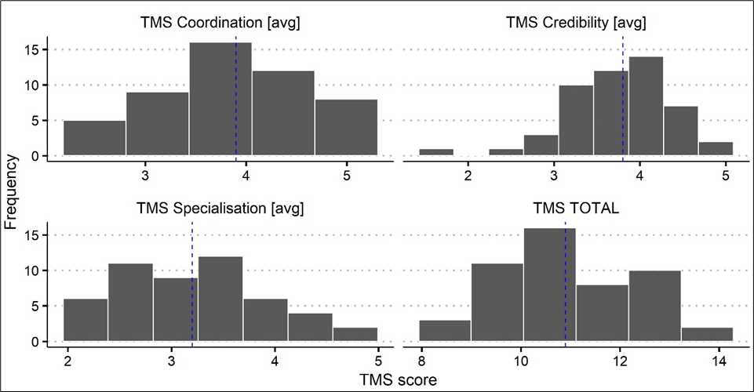
The Total TMS score has no correlation with Collective Intelligence (r=-0.02, p=0.94) - contrary to expectations, since the comprehensive literature review conducted individually on the two, points to the conclusion that both share common factors that are significantly correlated with their emergence in teams.
The higher the communication and interaction between team members, the less accurate, reliable and credible the knowledge shared within the team, becomes. This relates to the TMS component of Credibility.
Distribution of the TMS Components and TMS Total Scale (N=50)

Slide 39
Main Contributions

Slide 40
Contributions
Relates to the attention drawn to the relation between Collective Intelligence and Transactive Memory Systems. To the best of the researcher’s knowledge, the current study is the first to examine Transactive Memory Systems in relation to Collective Intelligence.
Relates to the emphasis placed in considering Collective Intelligence (CI) as a systemic dimension that can provide organizations with a methodological assessment of their maturity levels in dealing with Low Probability High Impact Events (LoPHIEs).
The present study is the first to verify a positive correlation between transactive memory and high complexity tasks, within the context of managing LoPHIEs with the use of CI.

Slide 41
Contributions
The current research has established a relationship between Collective Intelligence and the ability of spontaneously understanding the workings of the physical world – ability of understanding physical causality, as measured by the Folk Physics Test. To the best of the researcher’s knowledge, this is the first study to investigate Folk Physics in the context of CI.
The current study is also the first, to report results in regards to personality traits in correlation with Collective Intelligence, especially within the context of managing LoPHIEs. Even though previous studies conducted in the field of Collective Intelligence involved measuring the personality of the participants engaged, they fail to draw associations and identify correlations.

Slide 42
Contributions
Collective Intelligence Maturity Assessment (CIMA) Model
The findings of the present study provide valuable insight into a number of key issues related to the evolution and maturation of CI in teams as well as Collective Performance and provide a novel perception of the complex nature of the examined research subject. This research has identified some of the ideal characteristics a team must possess for the successful and sustainable management of LoPHIEs. These characteristics are incorporated in the proposed Collective Intelligence Maturity Assessment (CIMA) Model. In addition, the distinction made between the primary and secondary factors influencing the maturation of CI in teams and Collective Performance may be useful in both professional and academic contexts.

Slide 43
Managerial Implication
Provides organizations involved in the management of LoPHIEs, with insight valuable in taking an informed decision whether to assign a team or an individual to handle an activity within the management process of an adverse event, depending on the characteristics of the situation encountered and based on the demographic information of the responders. The task taxonomies reviewed in this Thesis, are valuable tools with practical applications and present an innovative platform for further academic research, with managerial implications.

Slide 44
Thank you for your attention!
Dr. Chrysostomi Maria Kyrillou – kyrillou.cm@unic.ac.cy

